Slide 1

How to Size an Accumulator
Ernie Parker
CFPAI, CFPE, CFPSD, CFPS, CFPMM, CFPMT, CFPMIP, CFPMMH, CFPMIH,
AJPP, AJPPCC, CC
ErnieParker1@msn.com 952-200-3359

Slide 2
1. Conversion for Metric
2. Basic calculations for pressure and volume when using all of the oil
3. Basic calculations when using part of the accumulator volume
4. Sizing an accumulator for a change in temperature
5. Sizing an accumulator with a isothermal condition
6. Sizing an accumulator with a adiabatic condition
7. Setting a pre-charge pressure
8. Charging accumulator
Outline

Slide 3
Conversion for Metric
Pressure 145 psi = 1 MPa
Absolute temperature 0° Kelvin = -273.15° below 0° Celsius
Absolute Temperature 0° Rankine = -459.67° below 0° Fahrenheit
Degrees C = °F - 32 x 5/9
Degrees F = °C x 1.8 + 32
3.7854 liters = 1 gallon
3785.4 cm³ = 1 gallon
16.39 cm³ = 1 in³

Slide 4
pₗ x Vₗ = p₂ x V2 (Gas Laws) (US Customary) V₂ – Vₗ = Usable volume of oil
Use these formulas if you use all of the oil in the accumulator
Given: 1 Gallon working between 3000 and 1000 psi
Use absolute values
pₗ =1000 psi + 14.7 (1014.7) Precharge
p₂ = 3000 psi + 14.7 (3014.7) Maximum working pressure
Vₗ = 231 cubic inches volume of accumulator
V₂ = Volume of gas
1014.7 x 231 = 3014.7 x V₂
V₂ = 77.75
Vₗ - V₂ = Volume of useable oil
231 – 77.75 = 153.25 Useable oil

Slide 5
pₗ x Vₗ = p₂ x V₂ = p₃ x V₃
V₃ - V₂ = Useable volume of oil
Use these formulas if you are working between maximum system pressure and minimum system pressure
pₗ = Pre-charge pressure
p₂ = Minimum working pressure
p₃ = Maximum working pressure
Vₗ = Volume of gas in accumulator (empty)
V₂ = Volume of gas at minimum working pressure
V₃ = Volume of gas at maximum working pressure
All pressures are in absolute pressure

Slide 6
Solving for an Accumulator with the Following Specifications:
(US Customary)
pₗ = 900 + 14.7 PSI (914.7) Pre-charge
p₂ = 1000 + 14.7 PSI (1014.7) Minimum working pressure
p₃ = 3000 + 14.7 PSI (3014.7) Maximum working pressure
Vₗ = 1 Gallon or 231 cubic inches
pₗ x Vₗ = p₂ x V₂
914.7 x 231 = 1014.7 x V₂ (914.7 x 231) / 1014.7 = V₂
V₂ = 208.23 Cubic inches
p₂ x V₂ = p₃ x V₃
1014.7 x 208.23 = 3014.7 x V₃ (1014.7 x 208.23) / 3014.7 = V₃
V₃ = 70.09 Cubic inches
V₂ - V₃ = Volume of Oil
208.23 – 70.09 = 138.15 Cubic inches of useable oil

Slide 7
Solving for an Accumulator with the Following Specifications:
(Metric)
pₗ = 6.2069 + .1013 MPa (6.3082) Pre-charge
p₂ = 6.8966 + .1013 MPa (6.9979) Minimum working pressure
p₃ = 20.6897 + .1013 (20.7913) Maximum working pressure
Vₗ = 3785.4 cm³
pₗ x Vₗ = p₂ x V₂
6.3082 x 3785.4 = 6.9979 x V₂ 6.3082 x 3785.4 / 6.9979 = V₂
V₂ = 3412.3180 cm³
p₂ x V₂ = p₃ x V₃
6.9979 x 3412.3180 = 20.7913 x V₃ (6.9979 x 3412.0180) / 20.791 = V₃
V₃ = 1148.67
V₂ - V₃ = Volume of Oil
3412.3180 – 1148.67 = 2263.65 cm³ / 16.39 = (138.11 in³)

Slide 8
Solving for a Change in Temperature (US Customary)
Pₗ x Vₗ x T₂ = P₂ x V₂ x Tₗ
Pₗ = 1000 psi + 14.7 = (1014.7)
P₂ = 3000 psi + 14.7 = (3014.7)
Vₗ = 231 in³
V₂ = 100 in³
Tₗ = 70°F Initial temperature + 460° (530°Rankine)
T₂ = Final temperature + 460° (Rankine)
1014.7 x 231 x T₂ = 3014.7 x 100 x 530
T₂ = (3014.7 x 100 x 530)
(1014.7 x 231)
T₂ = 681.66° Rankine – 460 = 221.66°F

Slide 9
Solving for a Change in Temperature (Metric)
Pₗ x Vₗ x T₂ = P₂ x V₂ x Tₗ Pₗ = 6.8966 MPa + .1013 = (6.9979}
P₂ = 20.6897 MPa + .1013 = (20.7910)
Vₗ = 3785.4 cm³
V₂ = 1637 cm³
Tₗ = 21°C Initial temperature + 273 = (294 Kelvin)
T₂ = Final temperature + 273 (Kelvin)
6.8966 x 3785.4 x T₂ = 20.7910 x 1637 x 294
T₂ = 20.7910 x 1637 x 294
6.9979 x 3785.4
T₂ = 377.74° Kelvin – 273° = 104.739°C
104.739 x 1.8 +32 = (220.5°F)

Slide 10
Sizing an Accumulator with a Temperature Change (US Customary) Over a Period of One Minute or Greater. (Isothermal)
pₗ x Vₗ x T₂ = p₂ x V₂ x Tₗ (Use Absolute Values)
Example:
pₗ = Precharge pressure (1000 + 14.7)
p₂ = Maximum system pressure (3000 + 14.7)
Vₗ = Initial volume of gas (231)
V₂ = Final volume of gas (Unknown)
Tₗ = Initial temperature (70°F + 460) = 530
T₂ = Final temperature (100°F +460) = 560
1014.7 x 231 x 560 = 3014.7 x V₂ x 530
V₂ = (1014.7 x 231 x 560)
(3014.7 x 530) V₂ = 82.15 in³ of gas
Vₗ - V₂ = 231 – 82.15 = 148.85 in³ of oil

Slide 11
Sizing an Accumulator with a Temperature Change (Metric) Over a Period of One Minute or Greater. (Isothermal)
pₗ x Vₗ x T₂ = p₂ x V₂ x Tₗ (Use Absolute Values)
Example:
pₗ = Precharge pressure 6.8966 + .1013 (6.9979 MPa)
p₂ = Maximum system pressure 20.6897 + .1013 (20.791MPa)
Vₗ = Initial volume of gas (3785.4 cm³)
V₂ = Final volume of gas (Unknown)
Tₗ = Initial temperature (21°C + 273) = 294° Kelvin
T₂ = Final temperature (38°C +273) = 311° Kelvin
6.9979 x 3785.4 x 311 = 20.79 x V₂ x 294
V₂ = (6.9979 x 3785.4 x 311)
(20.791 x 294) V₂ = 1347.77 cm³
Vₗ - V₂ = 3785.4 – 1347.77 = 2437.63 cm³ (148.73 in³)

Slide 12
Sizing an Accumulator with a Change in Temperature of Less Than One Minute
(Adiabatic)
Notes:
This actually varies between one minute and 0 time.

Slide 13
Adiabatic
US Customary
Vₗ = 231 in³
Vu = Unknown useable volume of oil
Pₗ = 900 + 14.7 psi
P₂ = 1000 + 14.7 psi
P₃ = 3000 + 14.7 psi
n = 1.4
Vu = 231 x [.93 - .43]
Vu = 231 x .5 = 115.93 in³
useable oil

Slide 14
Metric
Adiabatic
Vₗ = 3785.4 cm³
Vu = Unknown useable volume of oil
Pₗ = 6.2069 + .1013 = (6.3082) MPa
P₂ = 6.8966 + .1013 = 6.9979 MPa
P₃ = 20.6897 + 1013 = 20.7910 MPa
n = 1.4
Vu = 3785.4 x [.9285 - .4267]
Vu = 3785.4 x .5018 = 1899.34 cm³ 115.91in³
useable oil

Slide 15
Suggestion: When pre-charging an accumulator, start with a pre-charge pressure of 90% of your minimum working pressure. This will give you the maximum amount of useable oil.

Slide 16


HAD ENOUGH?
QUESTIONS?

Slide 17
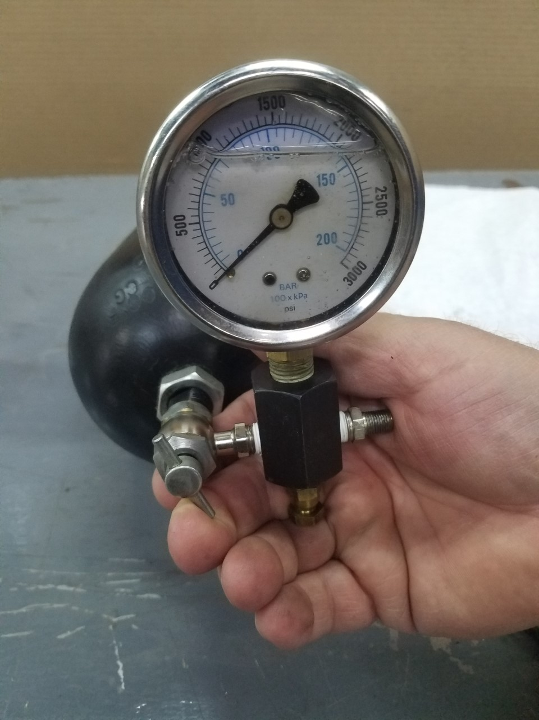

Slide 18
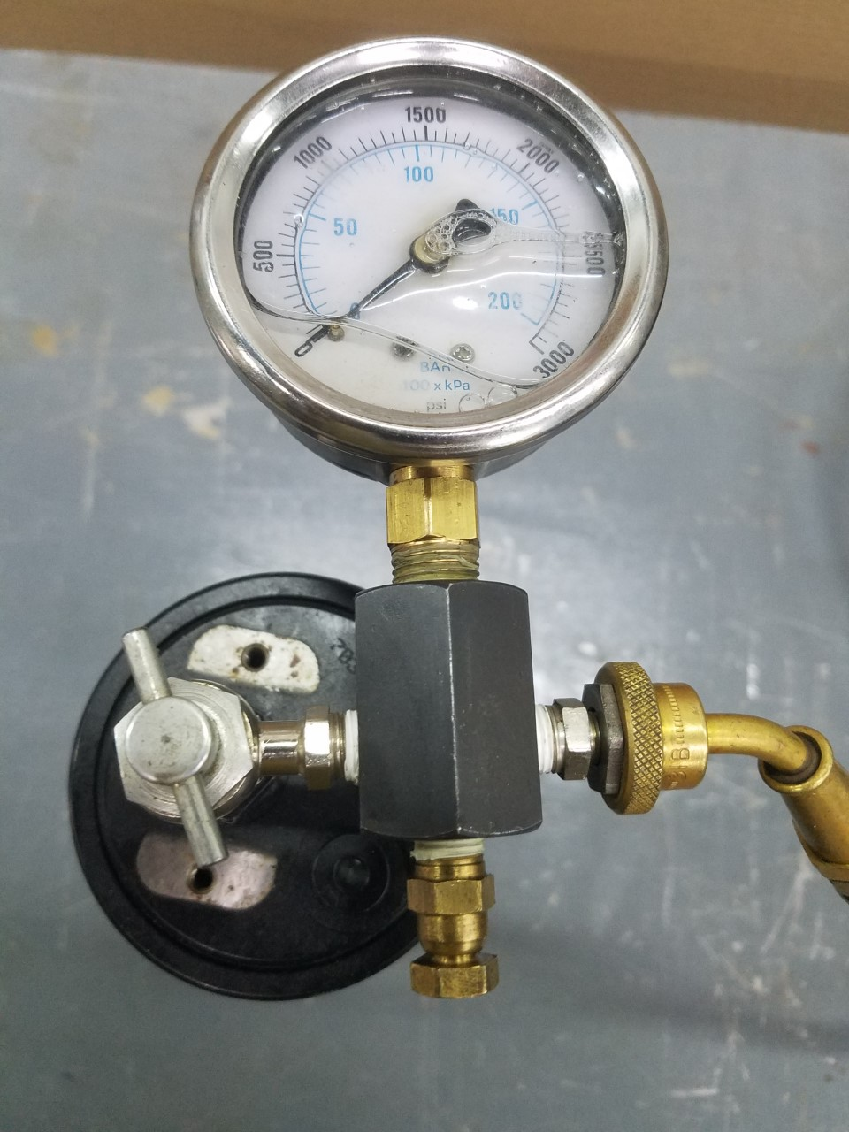

Slide 19
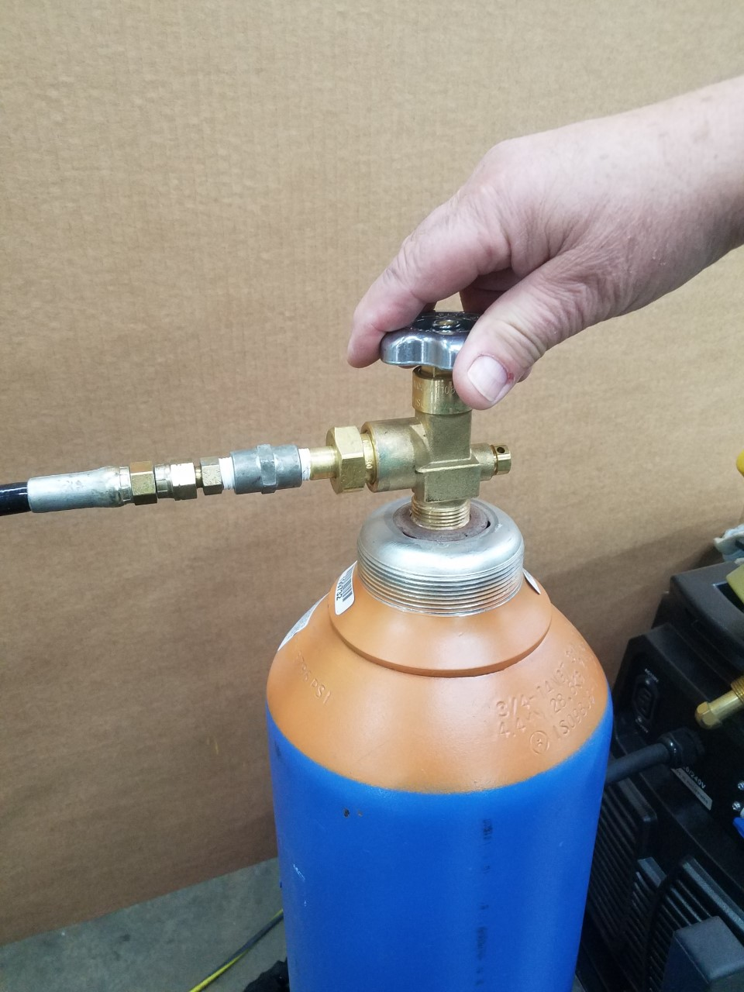

Slide 20
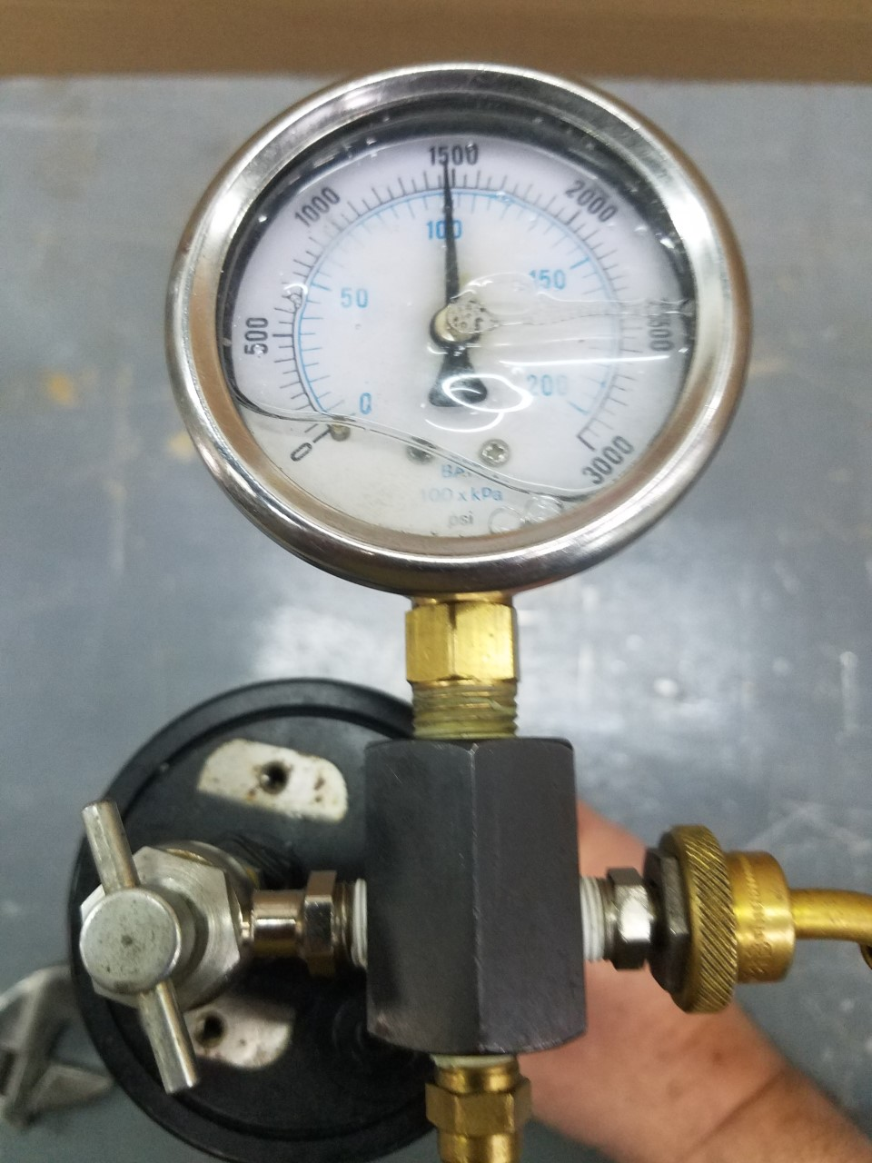

Slide 21
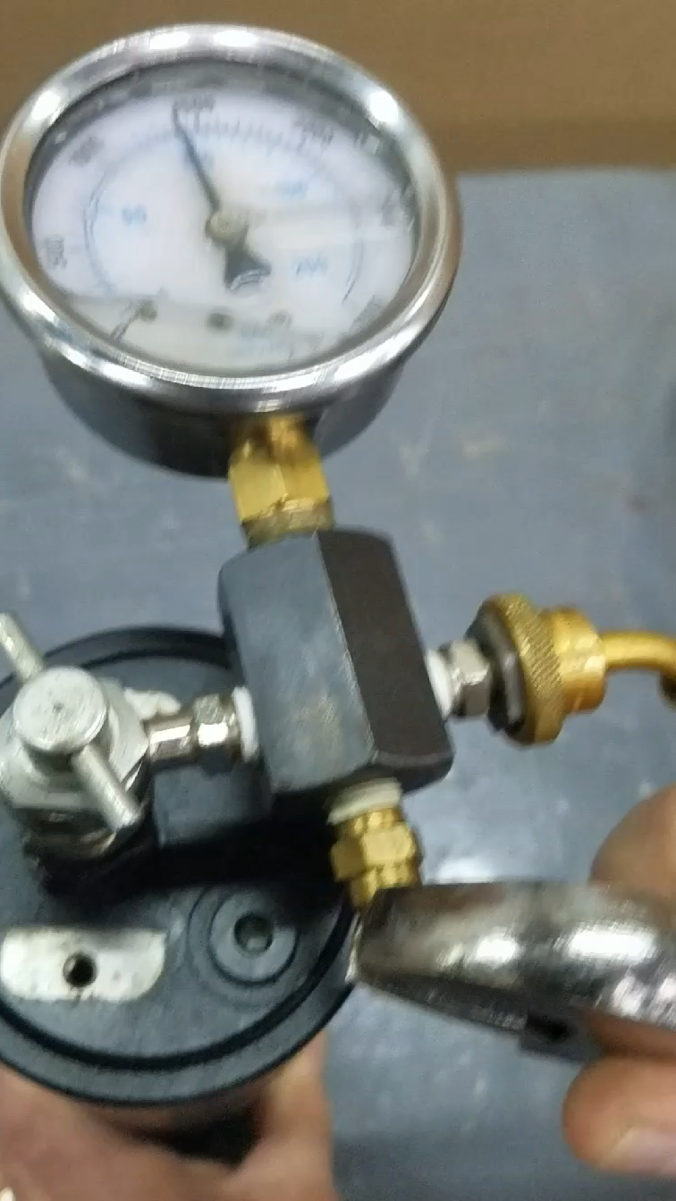

Slide 22
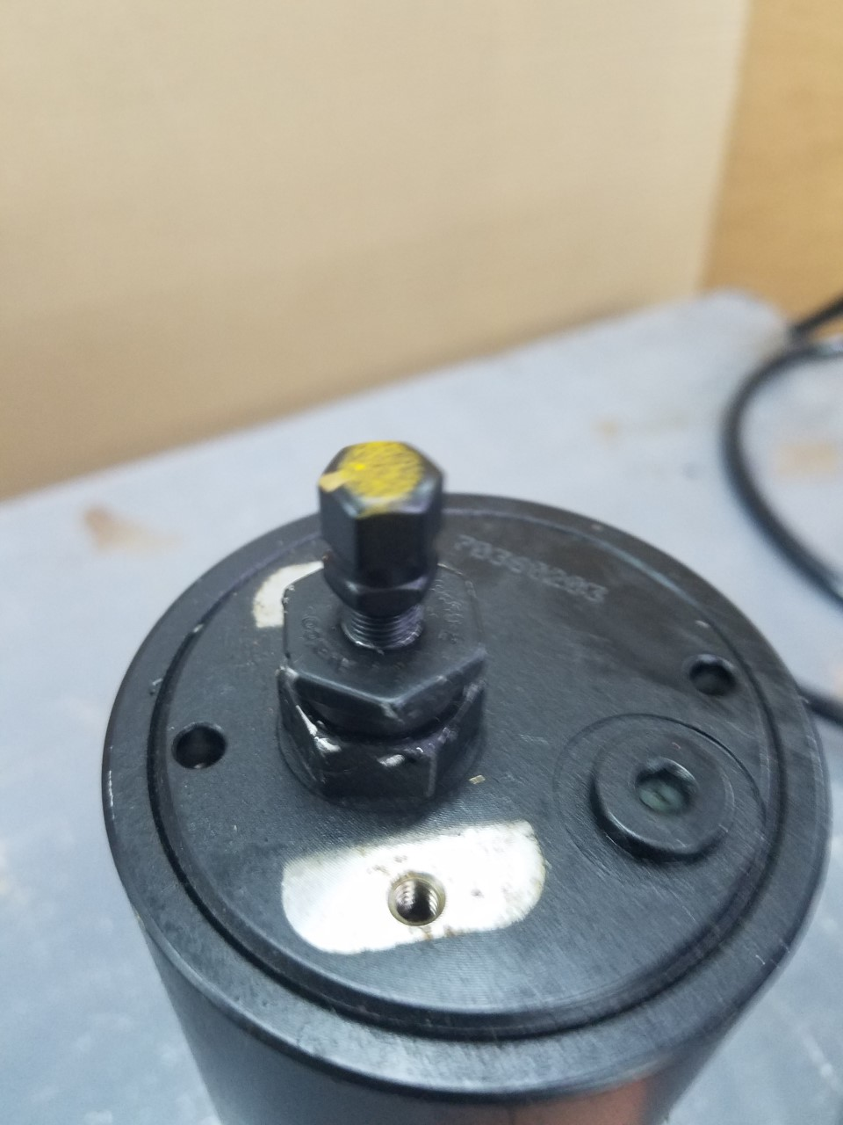

Slide 23
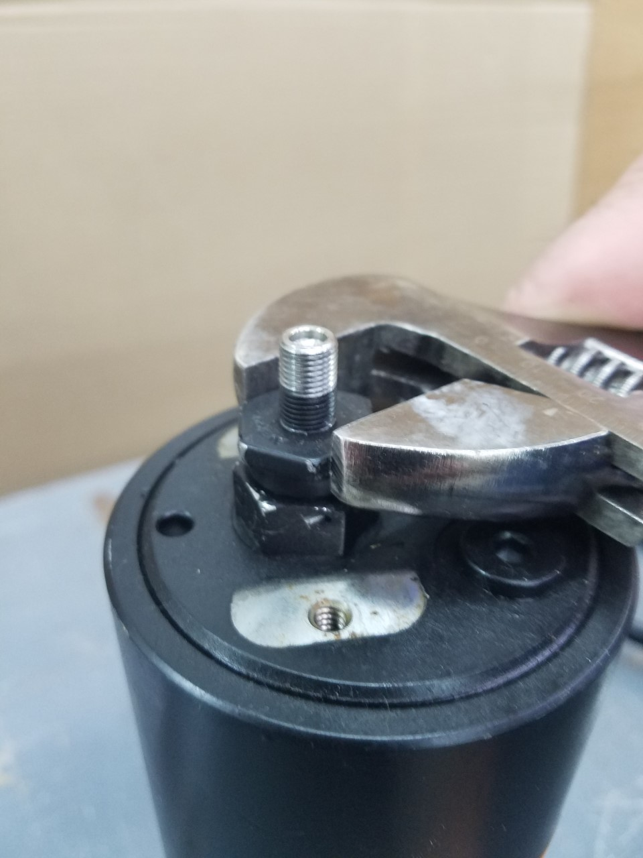

Slide 24

Questions?
ErnieParker1@msn.com

