Slide 1
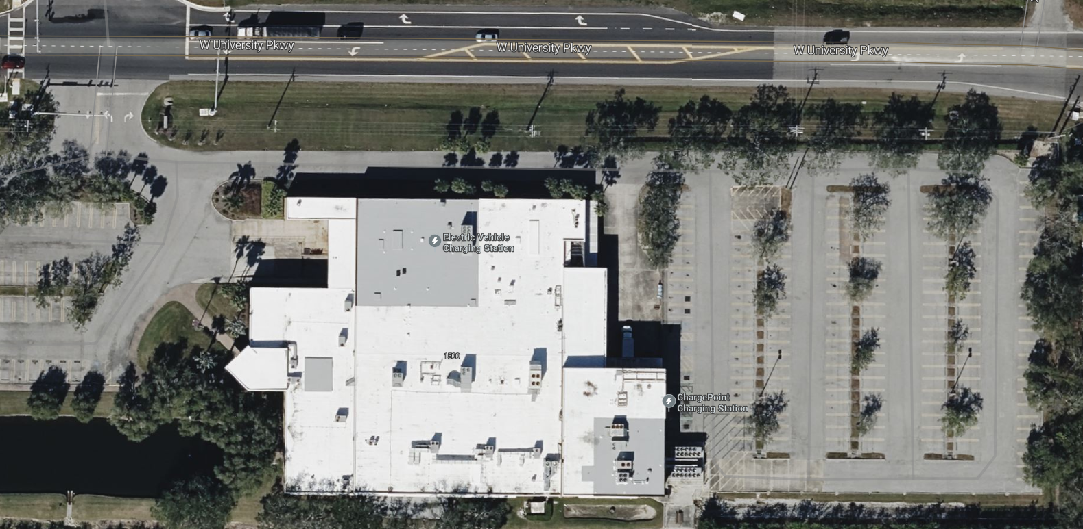
Track Layout ELEVATIONS
28 FT.
38 FT.
39 FT.
36 FT.
36 FT.

Slide 2
Track Layout SPRINT RACE
Sprint/Regen Demo
Efficiency/Endurance

Slide 3
Track Layout ENDURANCE & Efficiency RACE
200 FT.
220 FT.
220 FT.
200 FT.

