Slide 1
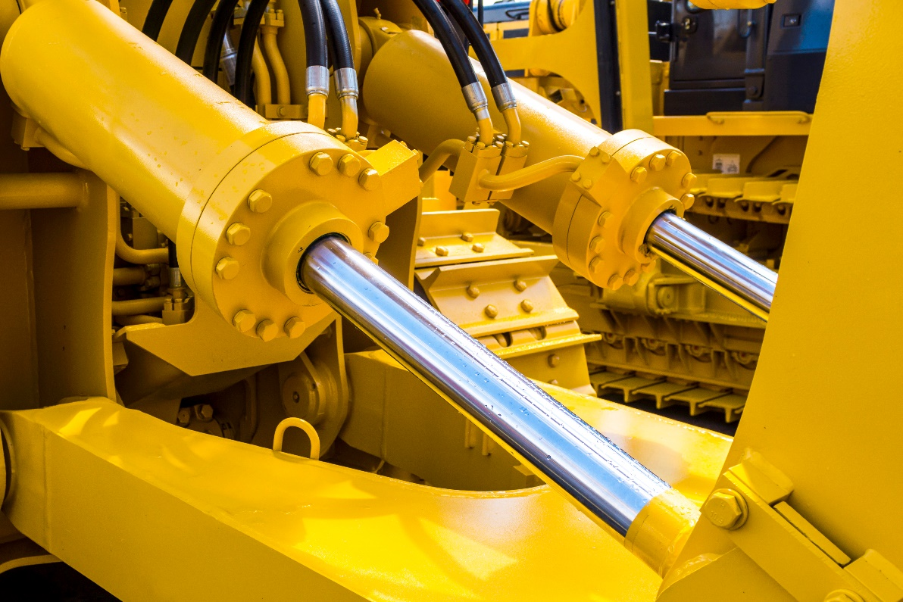

Originated by: Price Engineering

Slide 2
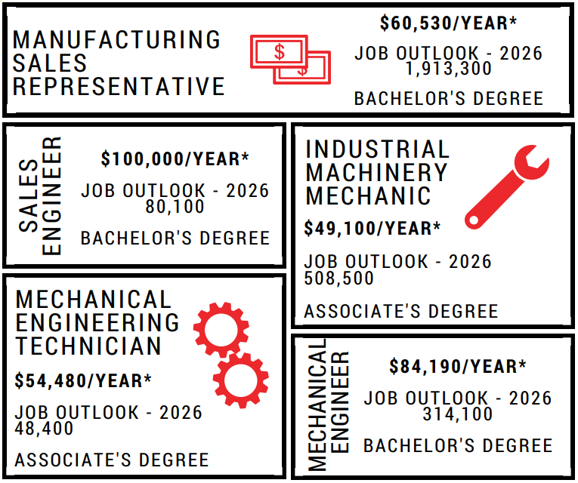
Career Paths
Engineering Career Paths
Technical Career Paths
*Salaries represent median pay source: All statistics from U.S. Bureau of Labor Statistics

Slide 3
Personal History
Are you an industry professional? Use this opportunity to talk about your history and insight about your role.

Slide 4

Fluid Power is behind the scenes in many industries and there may be a job waiting for you there:
Energy: From offshore drilling to underground mines, and from wind power to finding new means of energy efficiency, Fluid Power is a vital ingredient.

Slide 5
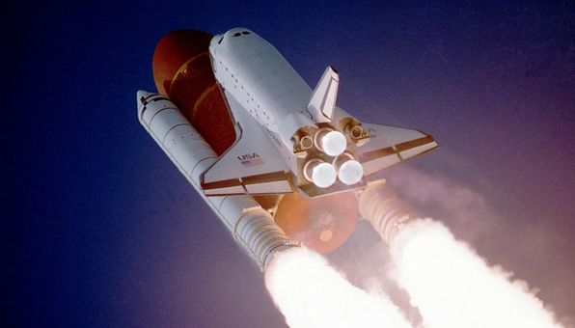

Fluid Power is behind the scenes in many industries and there may be a job waiting for you there:
Aerospace: Whether on a plane, helicopter or shuttle in outer space, Fluid Power is there to help enable flight. From design to ground crew, fluid power is a daily part of the industry.

Slide 6
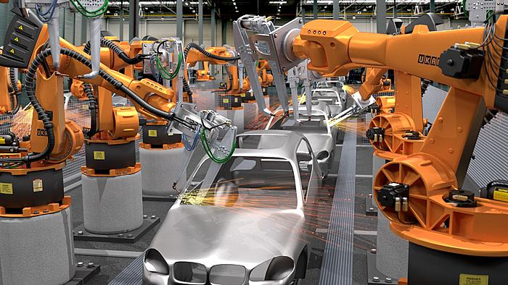
Fluid Power is behind the scenes in many industries and there may be a job waiting for you there:
Automation: The modern factory wouldn’t be very modern without Fluid Power as it works hand in hand with electrics, electronics and robotics in today’s state-of-the-art facilities.

Slide 7

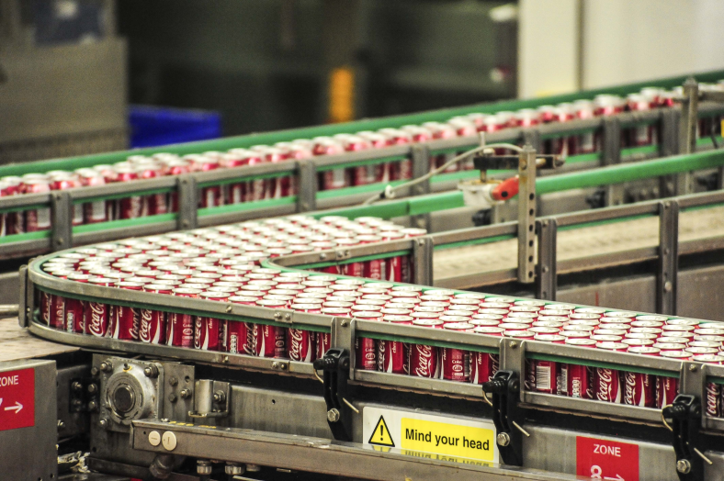
Fluid Power is behind the scenes in many industries and there may be a job waiting for you there:
Agriculture: It is Fluid Power that provides the horsepower for modern farming equipment out in the field as well as the power that enables the food processing industry to wash, can and package food.

Slide 8

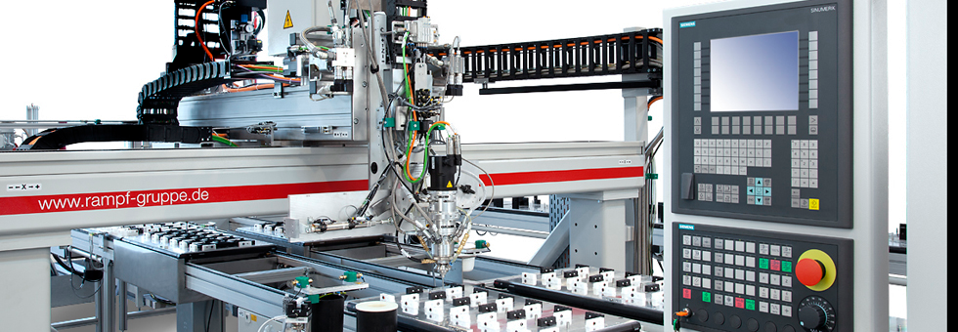
Fluid Power is behind the scenes in many industries and there may be a job waiting for you there:
Biomedical: Artificial kidneys, valve-assisted bladders and automatically dispensing medication equipment use Fluid Power. And yes, your dentist’s high speed drill relies on pneumatics for split second timing.

Slide 9
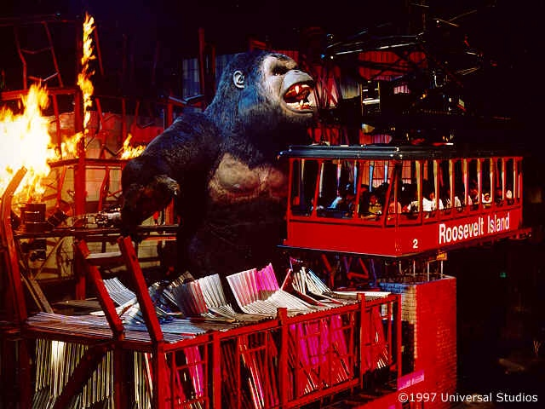
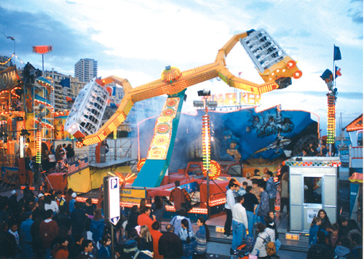
Fluid Power is behind the scenes in many industries and there may be a job waiting for you there:
Recreation: Roller coasters, ski lifts and even King Kong’s gargantuan toes owe their ability to move—and move you—to Fluid Power.

Slide 10
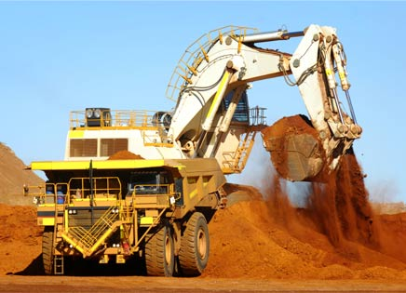
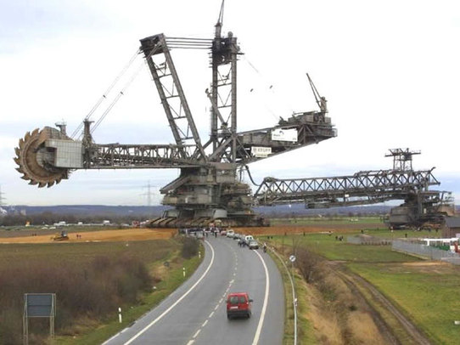
Fluid Power is behind the scenes in many industries and there may be a job waiting for you there:
Construction: The powerful machines that dig, crush, level and move earth would be mere weaklings without the power of Fluid Power.

Slide 11
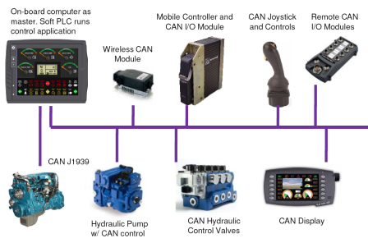
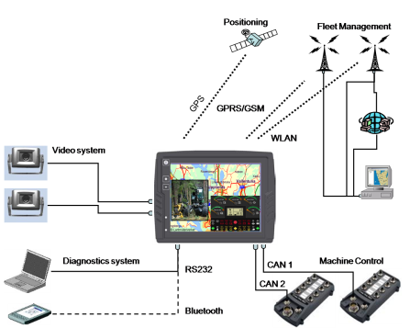

Mobile Solutions
CAN Networked Automation, Control & Remote Monitoring
Designs focused on a more productive, intelligent and reliable machine.
The Mobile Division at Price Engineering has the experience needed to help clients solve tough applications in the world of mobile equipment. Tough environments in markets like: Construction, Agriculture, Concrete, Marine, Mining, Forestry and Railway. We can help you successfully implement robust, versatile products and designed platforms utilizing CAN, CANopen,
CAN J-1939.

Slide 12
What kinds of careers are available in Fluid Power?
Engineers design Fluid Power systems and components as well as conduct research on new concepts, applications and improvements of existing installations.
Sales and Marketing personnel sell and market Fluid Power systems and components, working closely with Fluid Power manufacturers and distributors.
Mechanics assemble and install Fluid Power systems and components as well as troubleshoot and maintain Fluid Power systems on machines used in every facet of industry.
Technicians operate machines equipped with Fluid Power systems as well as manufacture and test Fluid Power systems and components.

Slide 13
What type of training do I need to get a job in Fluid Power?
Engineer – Four year college or university that offers mechanical engineering technology, industrial engineering technology, or any engineering technology program with a course of study in Fluid Power and electronics.
Sales-Marketing-Management – Requirements and qualifications for these careers vary depending on the technical level of the product sold or marketed or the business managed.
Mechanic/maintenance – One year program in Fluid Power from a technical institute, community college or vocational or technical school. Mechanic-technician certificate, associate degree or bachelor’s degree.
Technician – Two year program in Fluid Power from a technical institute, community college, area vocational or technical school or junior college, technician certificate, associate degree or bachelor’s degree.

