Slide 1

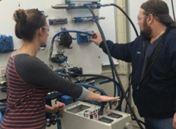
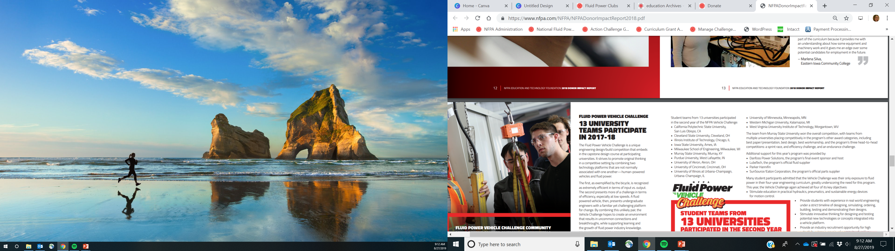
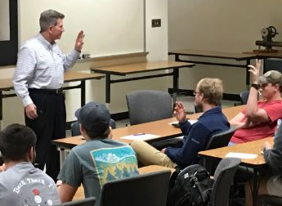
Fluid Power Club
Join [University]’s
Fluid Power Club
Work on educational and technical projects
Learn about job opportunities in the fluid power industry
Gain access to speakers and mentors in the fluid power industry
For further details, contact:
[Advisor Information]

