Slide 1

Careers in Fluid Power
Presented by:
Presenter Name, Title
Company Name
Email Address
company website URL

Slide 2

About Me [Presenter to Update]
Your name
Title
Length of service with company
School/degree
Areas of expertise
Why do you like working with fluid power?

Slide 3
About My Company [Presenter to Update]
Company overview
Type of fluid power technologies
Locations
Internship/job opportunities
Include exciting pictures or videos of how the work your company does is used in the world

Slide 4
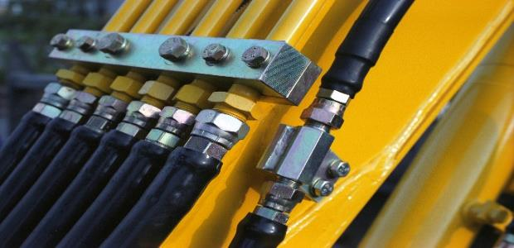
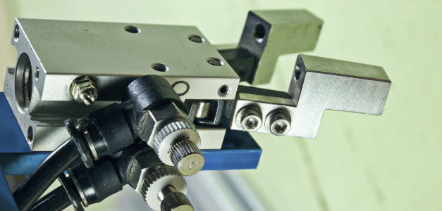
Fluid Power is a workhorse of the U.S. economy
Fluid power systems transmit more power in a smaller space than other forms of power transmission, making it the cross-cutting technology of choice for dozens of industries and hundreds of applications.
Advantages of hydraulics include:
High power to weight ratio
High torque at low speed
Ability to hold torque constant
Ruggedness and reliability
Advantages of pneumatics include:
Inexpensive and lightweight
Simple control systems
Clean and non-reactive in magnetic environments
Speed and precision
Notes:
Fluid power is a term that describes two related technologies: hydraulics and pneumatics.
Both technologies use a fluid – either a liquid or a gas – to transform power into controlled motion.
It is a workhorse of the U.S. economy.
Fluid power systems transmit more power in a smaller space than other forms of power transmission, making it the cross-cutting technology of choice for dozens of industries and hundreds of applications.
Among its many advantages, hydraulics offers:
High power to weight ratio;
High torque at very low speeds;
The ability to hold that torque constant;
And its overall ruggedness and reliability.
Among its many advantages, pneumatics is:
Comparatively inexpensive and lightweight;
Offers simple control systems;
Is clean and non-reactive in magnetic environments;
And activates with extreme speed and precision.

Slide 5


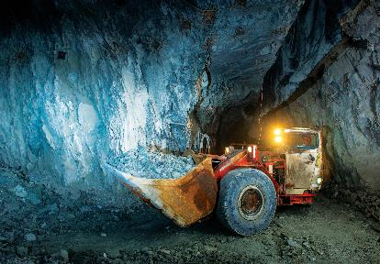



Fluid Power is everywhere
Aerospace
Power
Generation
Construction & Mining Equipment
Agricultural Equipment
Cars and Trucks
Entertainment
See more examples with #onlyfluidpowercan
Notes:
Because of these advantages, once you know where to look, you’ll find fluid power just about everywhere.
NFPA uses the social media hashtag #onlyfluidpowercan to educate the general public on fluid power’s impact on their lives.
For example:
In aerospace, only fluid power can lift a jumbo jet, bank and roll a fighter plane, and keep a rocket on course.
In power generation, only fluid power can harvest energy from the wind and waves.
In construction and mining equipment, only fluid power can build roads and buildings, moving mountains when necessary.
In cars and trucks, only fluid power can make these vehicles easy to steer and stop and provide the regenerative power to boost fuel efficiency.
In agricultural equipment, only fluid power can feed the world by planting and harvesting massive fields.
In entertainment, only fluid power only fluid power can animate the rides and monsters at our amusement parks.

Slide 6
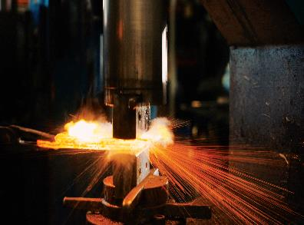

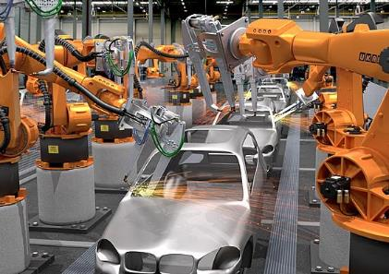

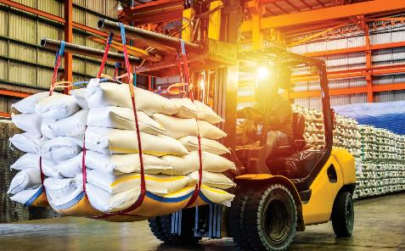

Fluid Power is everywhere
Lawn & Garden
Equipment
Factory Automation
Metalworking
Food Processing & Packaging
Material Handling
Biomedical
See more examples with #onlyfluidpowercan
Notes:
In metalworking, only fluid power can push, pull, press, cut, and transform raw materials into finished products.
In lawn and garden equipment, only fluid power can deliver the perfect cut for your backyard or favorite golf course.
In factory automation, only fluid power can automate the heavy and precise manufacturing processes that keep our economy moving.
In food processing and packaging, only fluid power can keep today’s food production processes clean and safe.
In material handling, only fluid power can keep global supply chains moving.
And in biomedical, only fluid power can precisely control the life-saving and sustaining equipment in our nation’s hospitals.
These are just some of the places where you can find fluid power in action.
Next time you’re out and about – look around.
You might just be surprised by what fluid power is doing in your world.

Slide 7
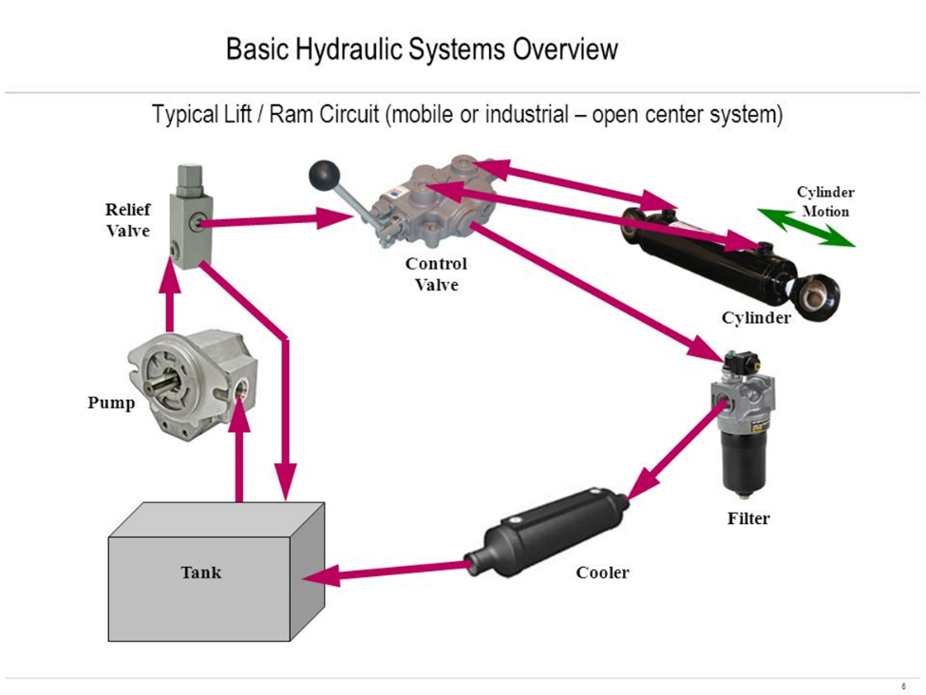
Basic hydraulic system and components
Notes:
And here’s what to look for.
The next time you have the chance, look closely at one of those pieces of construction or agricultural equipment, and you’ll undoubtedly see all the major components of the basic hydraulic system.
Understanding a fluid power system means following the fluid as it makes its circuit – and the fluid is the most essential component of all.
It begins in the tank or the reservoir.
From there it is drawn into and then turned into pressurized flow by the pump, which sends it on to the rest of the system.
Most hydraulic systems first have a relief valve, that allows over-pressurized fluid to return safely to the tank.
Otherwise the fluid is sent through a series of control valves, which can direct the flow to the various actuators on the machine to do the work.
Here, we see only one actuator – a cylinder, that can extend or retract, depending on which end receives the pressurized fluid.
Cylinders are usually the most visible component – picture the long cylinders that lift the bulldozer’s bucket and load into the air – but an actuator could also provide rotary motion to turn a wheel or otherwise propel the machine forward.
When the work is done, the unpressurized fluid has to return to tank, but before doing so it usually passes through a filter to keep it clean, and sometimes a cooler or a heat exchanger to remove any excess heat that has been built up.
From the tank, the fluid starts the same circuit over again, returning to the pump for re-pressurization.

Slide 8
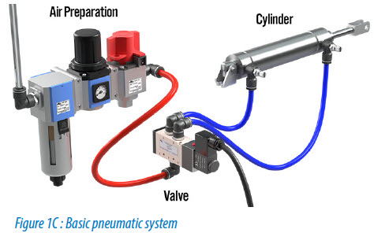
Basic pneumatic system and components
Notes:
Your basic pneumatic system operates on many of the same principles, but usually even fewer components are used.
The next time you’re in an automated factory, look closely at the production machines, and you’ll undoubtedly see all the major pneumatics components.
Not shown here is the air compressor, which feeds the pneumatic system with the pressurized air in needs to function.
That air first passes through an air preparation module – sometimes called an FRL, for filter, regulator, lubricator – which cleans, controls the pressure, and slightly lubricates the air to minimize damage to the downstream components of the pneumatic system.
Control valves are also used in pneumatic systems, which directs the air flow to the various actuators on the machine.
And those actuators are almost always cylinders, providing quick and precise linear motion – extending and retracting, depending on which end receives the pressurized air.
When complete, the remaining air is usually vented safely to atmosphere, which is what makes the hissing sound associated with most pneumatic systems.

Slide 9

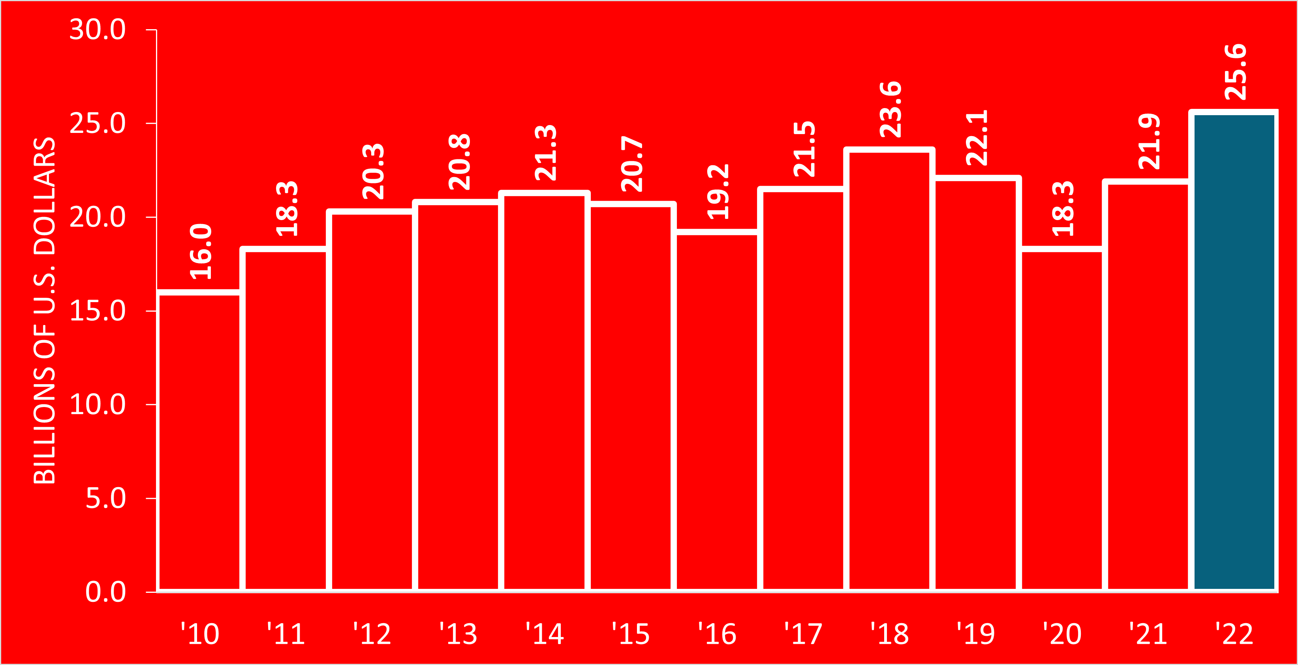
Fluid power is a $26.5 billion business in the U.S.
Notes:
When we talk about the U.S. fluid power industry – it is the manufacture of these components that we are talking about.
The pumps, the motors, the valves, the cylinders, the actuators, and the hoses and fittings that connect them all.
And as you can see by this chart, that industry is about a $26.5 billion business in the United States.
Of the total, roughly 77% of the business is hydraulics, and 23% of the business is pneumatics.

Slide 10

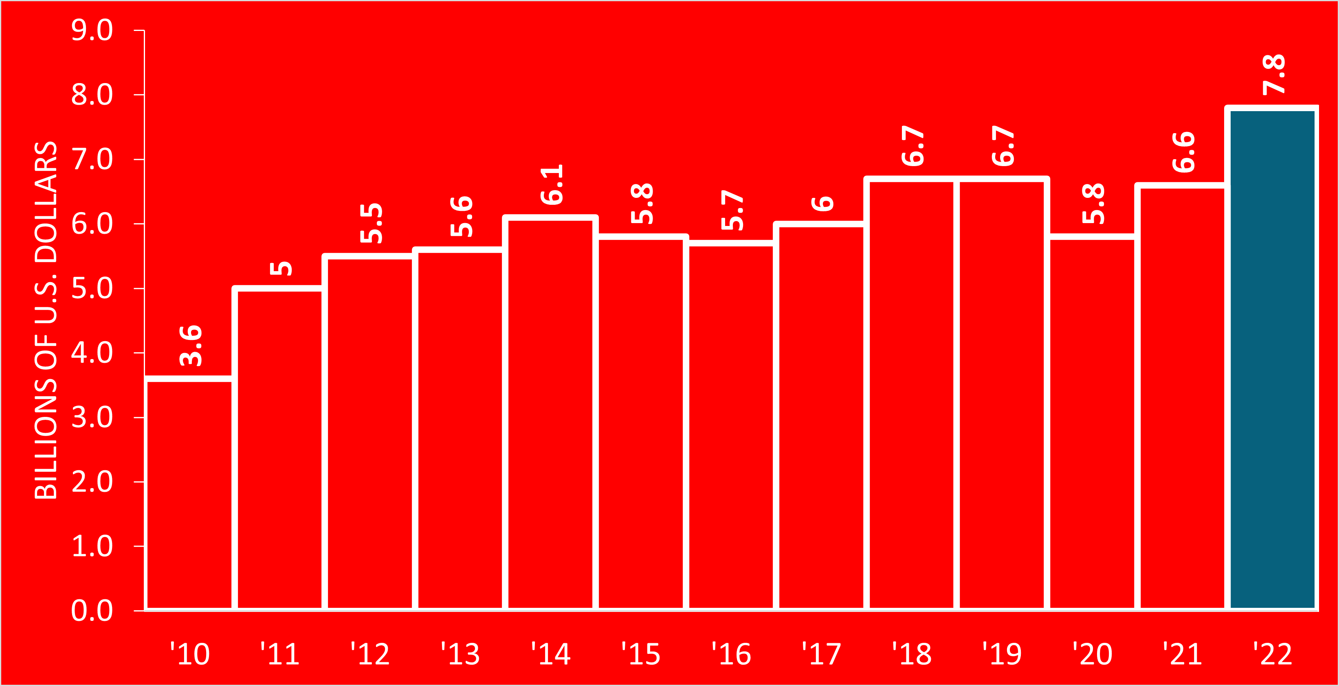
U.S. fluid power is competitive around the world
Notes:
And, U.S. fluid power products are strongly competitive around the world.
In 2022, the value of U.S. exports of fluid power reached an all-time high of $8.3 billion.

Slide 11
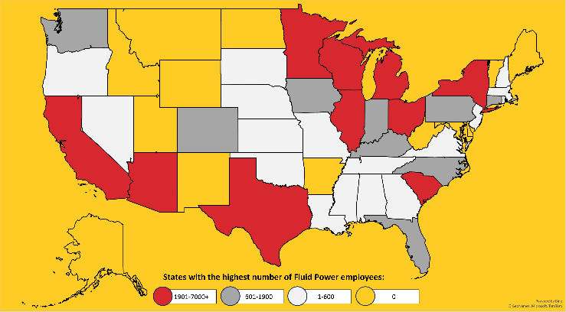
Fluid power employs 61,000 people in the U.S.
772 companies making fluid power products in the U.S.
Notes:
U.S. fluid power is also a significant employer in the United States.
The U.S. Census Bureau tracks employment data for hundreds of industries through its North American Industry Classification System (NAICS).
Three of those classifications have a direct impact on the U.S. fluid power industry.
Together, these three codes represent companies that manufacture fluid power pumps, motors, valves, cylinders, actuators, and hose fittings.
Based on an analysis of these codes, and the data collected by the U.S. Census Bureau, we can estimate that at least 772 companies are engaged in these activities in the United States.
Collectively, these companies employ 61,000 people with an annual payroll of at least $4.4 billion.
These fluid power employers reside in 36 of the 50 U.S. states.
The ten states with the highest number of these employers are California, Texas, Ohio, Michigan, Illinois, Wisconsin, Pennsylvania, Minnesota, Florida, and New York.

Slide 12
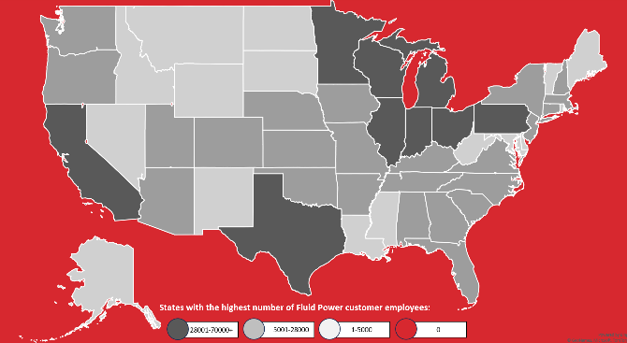
Customers employ 935,000 people in the U.S.
Notes:
If we measure fluid power by its impact on all the industries it serves, however, we see a much more robust picture.
Key industries that depend on fluid power include construction machinery, agricultural machinery, automotive (including light trucks), class 4-8 trucks (including vocational trucks), material handling (including conveying), industrial machinery and many more.
Collectively, these companies employ 935,000 people with an annual payroll of at least $75 billion.
These fluid power-dependent employers reside in nearly all 50 U.S. states.
The ten states with the highest number of these employers are California, Michigan, Illinois, Ohio, Texas, Florida, Pennsylvania, New York, Wisconsin, and Indiana.
Clearly, the fluid power industry and the many industries it helps support are a key part of the economic base of this country.

Slide 13
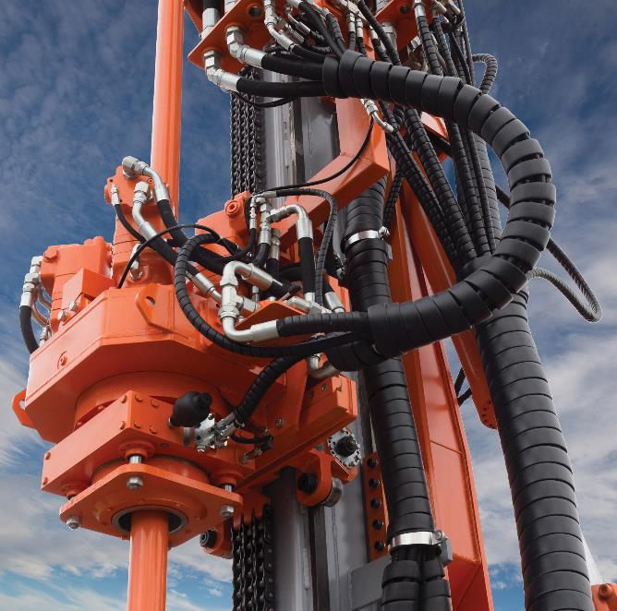
Exciting career opportunities
Design Engineers design fluid power systems and components as well as develop new concepts, applications and improvements of existing installations.
Sales Engineers market and sell fluid power systems and components, working closely with fluid power manufacturers, distributors, and customers.
Mechanics assemble and install fluid power systems and components, as well as troubleshoot and maintain systems on machines used in every facet of industry.
Technicians operate machines equipped with fluid power systems as well as manufacture and test fluid power systems and components.
Notes:
There are many exciting career opportunities in the fluid power industry.
NFPA Member Companies report that…
They need Design Engineers who can design fluid power systems and components as well as develop new concepts, applications and improvements of existing installations.
They need Sales Engineers who can market and sell fluid power systems and components, working closely with fluid power manufacturers, distributors, and customers.
They need Mechanics who can assemble and install fluid power systems and components, as well as troubleshoot and maintain systems on machines used in every facet of industry.
And they need Technicians who can operate machines equipped with fluid power systems as well as manufacture and test fluid power systems and components.
Take a look at the fluid power system on the vertical drill pictured on this slide.
Machines like this are used to drill into solid rock, harnessing and focusing the incredible forces of their hydraulic systems for an otherwise impossible task.
Creating these complex systems – designing them, selling them, assembling them, maintaining them – is the challenging and rewarding work that the fluid power industry offers.
Anyone with a mechanical aptitude and a desire for variety in their work is a potential hire for our industry.

Slide 14
Here are average salaries and typical education
Position | Average Salary (From Bureau of Labor Statistics) | Typical Education
Design Engineer | $96,310 | Bachelor’s Degree
Sales Engineer | $108,530 | Bachelor’s Degree
Mechanic | $59,470 | High School
Technician | $61,190 | Associate’s Degree

Slide 15
NFPA represents 300 potential U.S. employers
Manufacturers design, manufacture and sell fluid power components
Distributors build and sell systems comprised of those components
Suppliers provide raw materials and other services needed to make those components
Suppliers
30%
Manufacturers
57%
Distributors
13%

Slide 16
How do I get started on a fluid power career?
Continue taking fluid power classes at your university.
Participate in the Fluid Power Vehicle Challenge capstone design team at your university.
Create or participate in the Fluid Power Club supported by NFPA at your university.
Get an International Fluid Power Society (IFPS) certification.
Contact (insert speaker name and contact info) with questions about the industry or about internships available at (company name).
Contact the Workforce Team at NFPA for more information at workforce@nfpa.com or 414-778-3344

Slide 17
Questions?

